Slide 1
PROJECT-p99
Team No-3
Mentor: MUNMUN BHAGHAT
Team members:
1) Parshuram Chavan
2) Pankaj Patil
3) Manoj Suthar
4) Vaibhav Pandey
5) Prathmesh Patil
6) Bhavuk Sharma

Slide 2
BUISNESS OBJECTIVE
Data provided is related to gold prices. The objective is to understand the underlying structure in your dataset and come up with a suitable forecasting model which can effectively forecast gold prices for next 30 days. This forecast model will be used by gold exporting and gold importing companies to understand the metal price movements and accordingly set their revenue expectations. Data provided is related to gold prices. The objective is to understand the underlying structure in your dataset and come up with a suitable forecasting model which can effectively forecast gold prices for next 30 days. This forecast model will be used by gold exporting and gold importing companies to understand the metal price movements and accordingly set their revenue expectations.

Slide 3
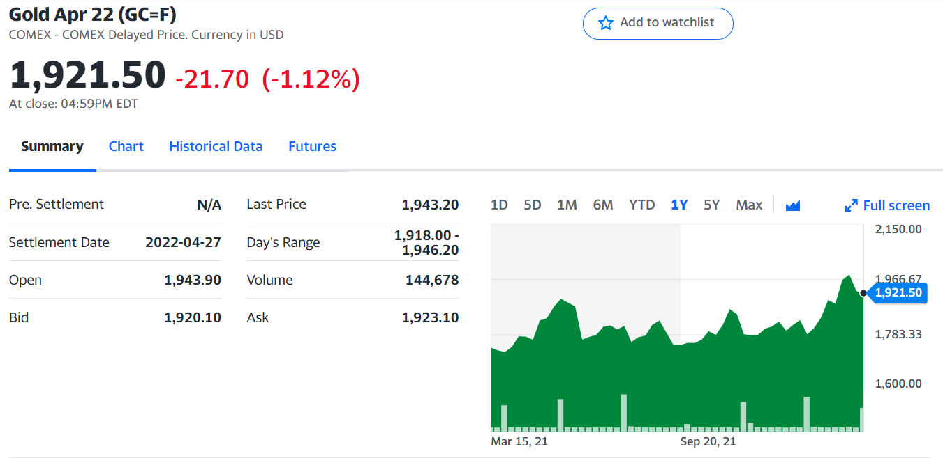
DATASET

Slide 4
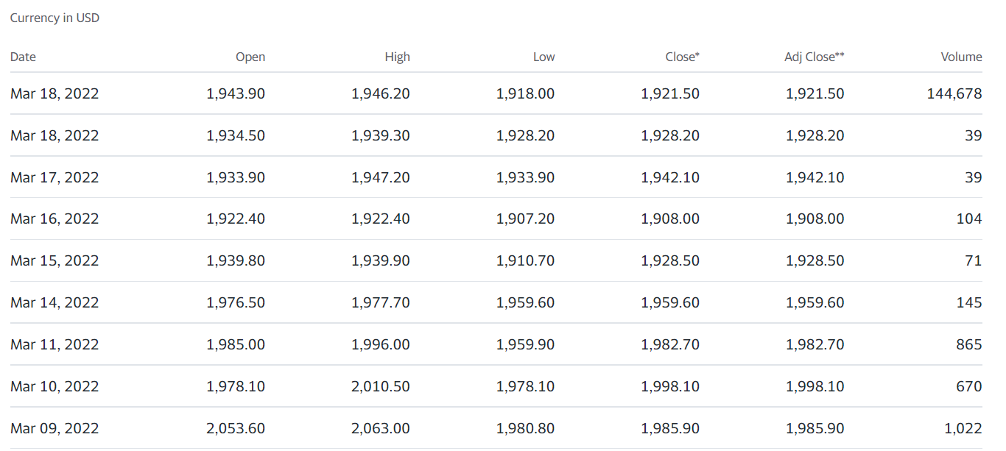
DATASET

Slide 5
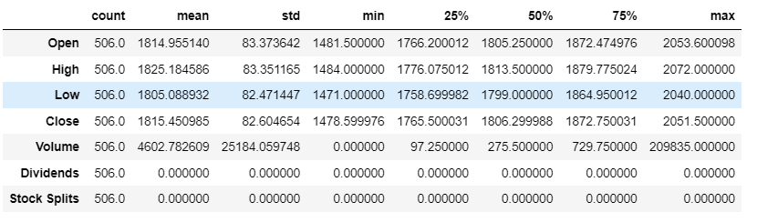
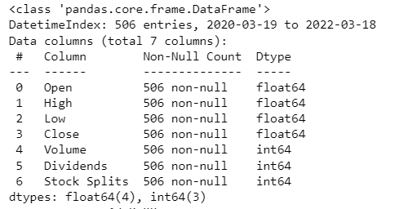
DATA understanding

Slide 6
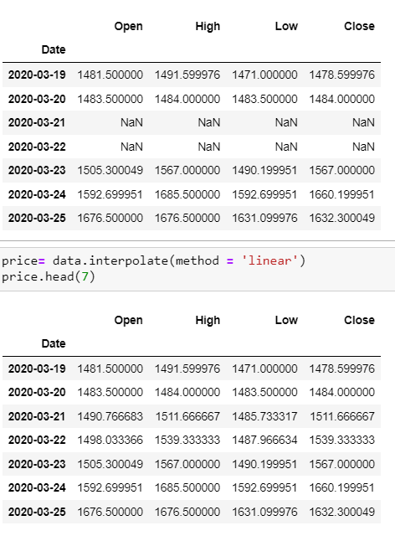
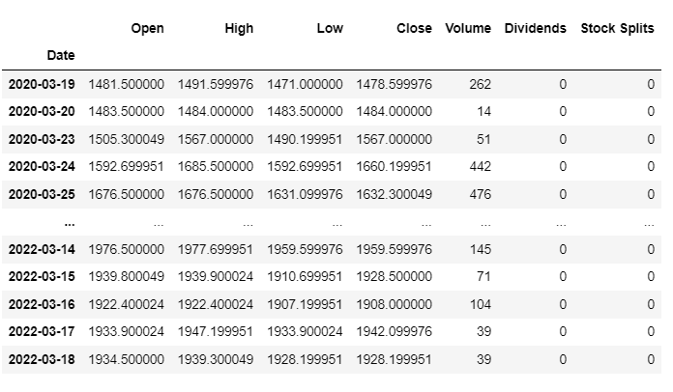
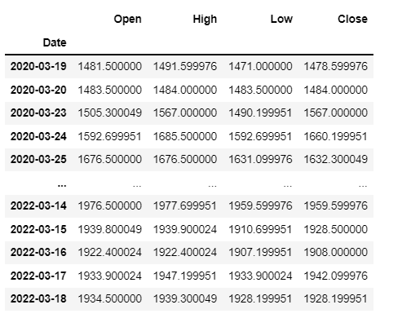
DATA PRE-PROCESSING &eda
Upsampling & Interpolation
Column Deletion

Slide 7
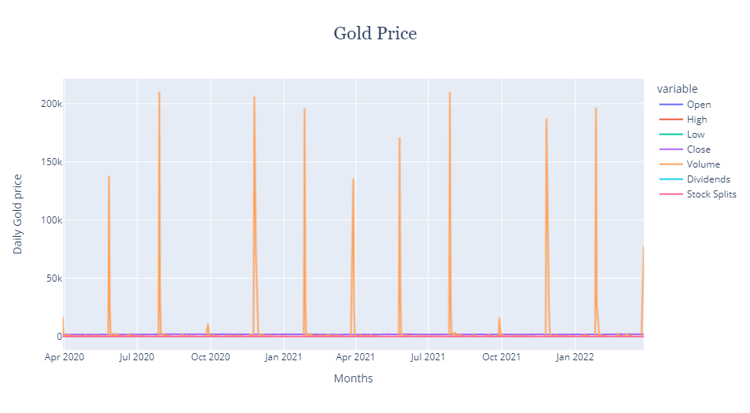
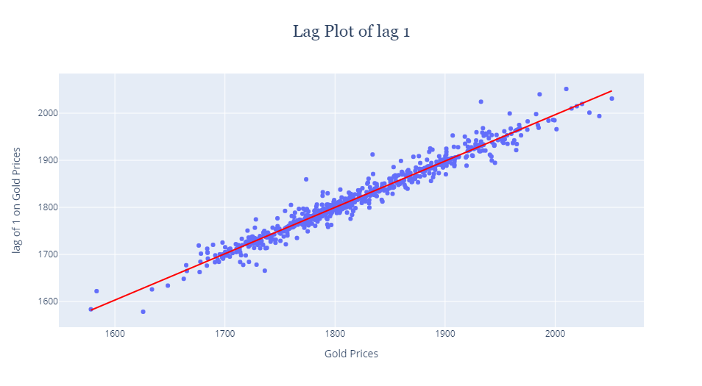
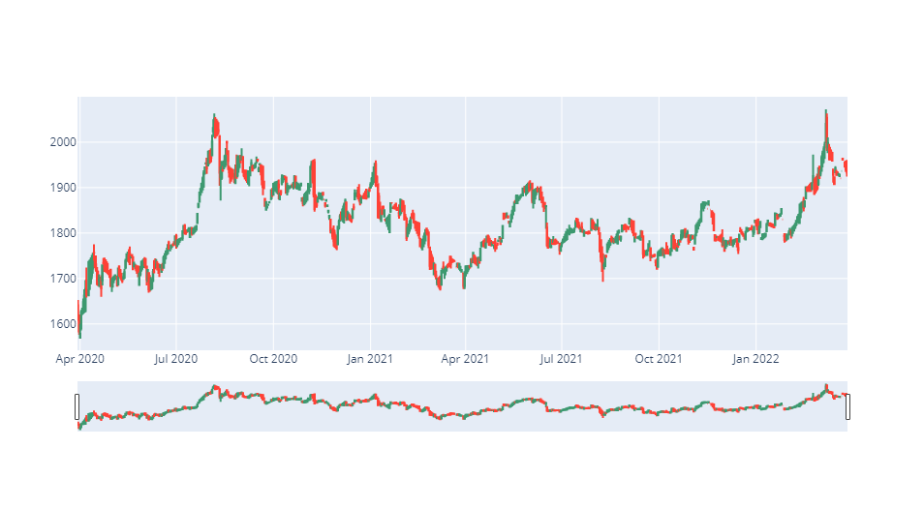
DATA VISUALISATION

Slide 8
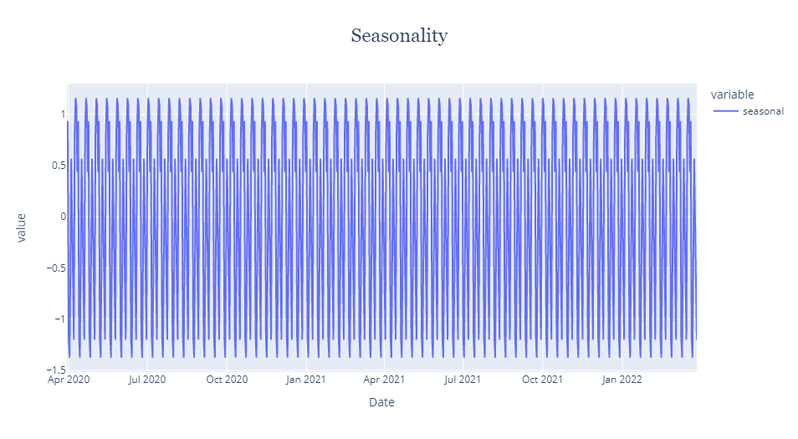
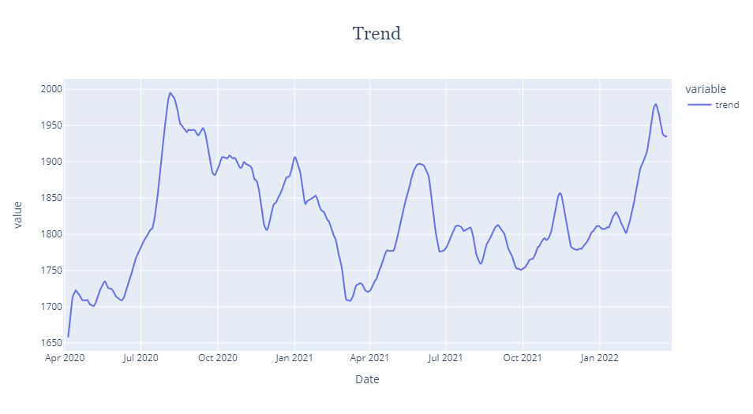
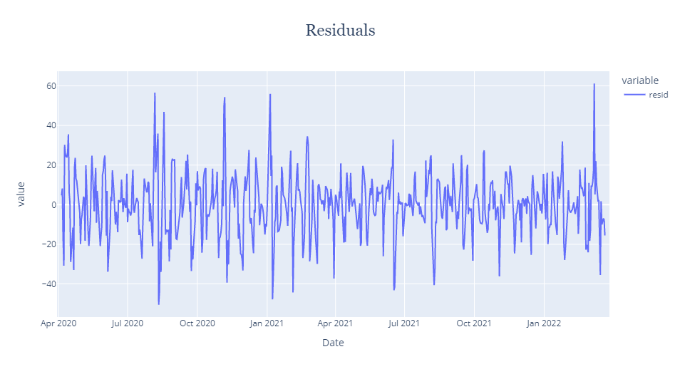
DATA VISUALISATION

Slide 9
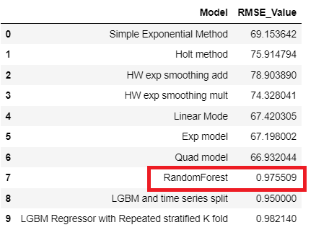
Model Selection & Evaluation
Accuracy = 99.70
MAE = 5.54

Slide 10
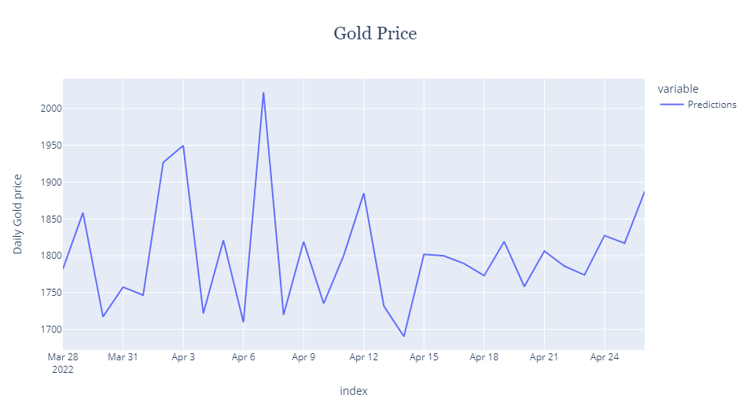
Prediction for 30 days

Slide 11

Diployment

Slide 12
https://share.streamlit.io/parsh8446/gold-price-prediction/main/gold_live_forecasting_using_rf.py

